Slide 1
Audit & Management Advisory Services Overview
David Meier, Director
Jennifer McDonald, Manager
Greg Buchanan, Manager

Slide 2
Agenda
AMAS Overview
Internal Audits
External Audits and Investigations

Slide 3
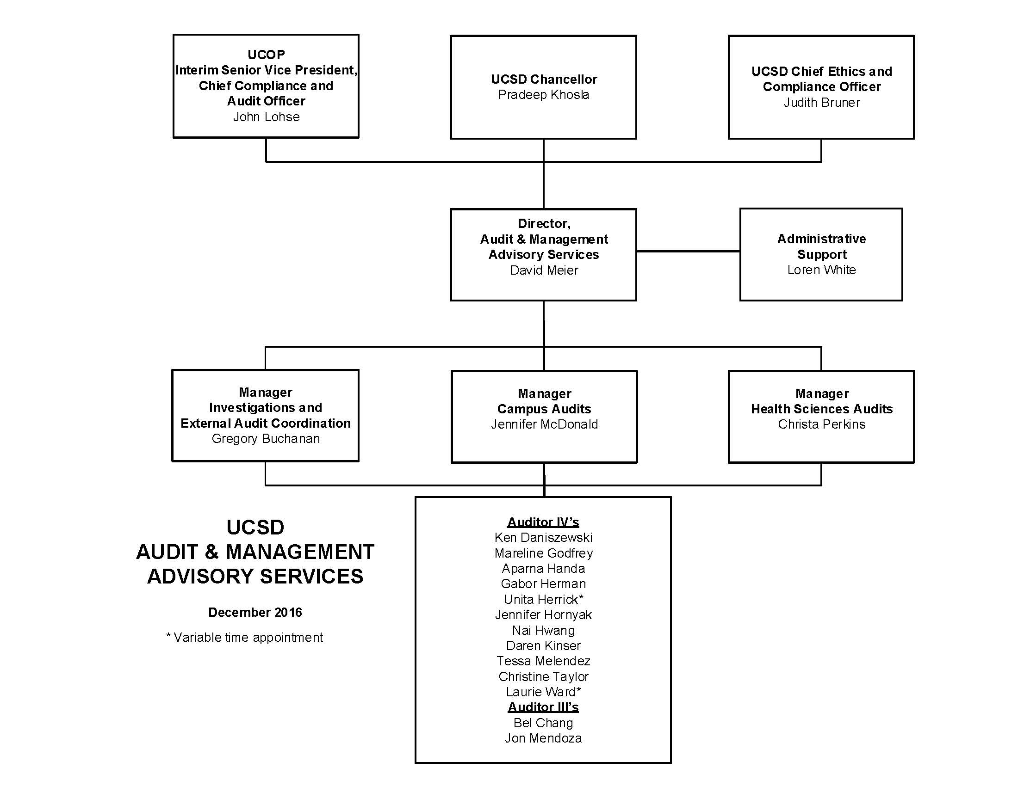
AMAS Organizational Chart

Slide 4
AMAS Service Lines
Audits
Planned audits – Based on risk
Supplemental Reviews/Management Requests
Advisory Services
Planned Advisory Services
Internal Control Education
External Audit Coordination
Investigations
Small Consultations
Re-engineering Projects/System Redesign
Committee/Workgroup Participation

Slide 5
Regulations
Federal Laws
Policies/ Procedures
Contract Terms and Conditions
Auditing: A formal process where activities and records are examined and compared to predetermined audit criteria.
Management Goals/ Benchmarks

Slide 6
Definition of Internal Auditing
Internal auditing is an independent, objective assurance and consulting activity designed to add value and improve an organization’s operations. It helps an organization accomplish its objectives by bringing a systematic, disciplined approach to evaluate and improve the effectiveness of risk management, control and governance processes.
Notes:
Types of Internal Audits conducted at UCSD include:
Financial – internal controls
Operational effectiveness
Compliance
Information Systems & IT Security
Integrated Audits – business processes and corresponding information systems

Slide 7
Scope of Internal Auditing Services
Preliminary Survey – Information Gathering
General - Organizational Structure; Objectives and goals; Business Office Responsibilities.
Financial - Budget information, operating results and financial data; departmental financial overview to gain an understanding of departmental financial transactional processes.
Operational – Review roles and responsibilities for payroll processing; purchasing activities; equipment management; travel and entertainment; contract and grant activities; etc.
Compliance – Review relevant policy and procedures (System wide, Campus, Departmental, Regulatory, Research).

Slide 8
Scope of Internal Auditing Services Cont’d
Risk Assessment - Evaluate relevant risks and management control activities for areas related to the department processes under review.
Detailed Audit Fieldwork/Testing – Analyzing data and information; evaluating the adequacy of internal controls.
Reporting – prepare draft report summarizing audit procedures and results.
Audit Follow-up – Meet at predefined time to assess corrective actions.

Slide 9
External Audit Coordination
Policy & Procedure Manual 300-5 – Audits & Investigations by External Agencies
Audit & Management Advisory Services (AMAS) has been delegated responsibility for the oversight of external fiscal audit activities at UCSD.
External audit notifications received directly by UCSD personnel are to be referred to AMAS.
DO NOT PROVIDE DOCUMENTATION DIRECTLY TO AN EXTERNAL AUDITOR WITHOUT CONSULTATION WITH AMAS.

Slide 10
External Audit Coordination
AMAS role as Liaison for external reviewers
Single point of contact
Schedule and attend opening meetings and interviews
Assist with providing audit agencies with relevant University policies
Assist with gathering project documentation
Assist with responding to Agency questions and concerns
Maintain project documentation file
Coordinate the University’s official response

Slide 11
External Audit Coordination
UCSD is subject to the scrutiny of several different federal audit entities.
And many more…

Slide 12
Non-Federal Agencies
State
California State Auditor
Board of Equalization
Department of Public Health
State Controller’s Office
Office of Traffic Safety
County
Health and Human Services Agency
Other Audit Services
PricewaterhouseCoopers – NCAA Compliance review
University of California Office of President - Conducts various audits some of which include, royalty audits, compensation audits, etc.

Slide 13
Types of External Audits
Compliance
Financial
Operational
Investigative
Information systems
Health care
Construction
Claimed Cost
Pre-award Audit
Indirect Cost Audit
General Control
Compliance Audit (A-133)

Slide 14
External Audit Metrics
Much of UCSD’s external audit activity comes from federal, state, and county agencies. In addition, the National Labs routinely conduct subcontract monitoring reviews, and a variety of other entities conduct reviews of extramural funding awarded to UCSD.

Slide 15
External Audit Process
While each agency’s audit process is specific to its own environment, most audit processes are similar to those listed in the following steps ⁽¹⁾
Audit Opening
Notification
Initial Discussion
Performing the Audit
Fieldwork
Reporting Results
Interim Findings / Draft Report
Closing Conference
Corrective Action
Opening Conference
Audit Plan
Final Audit Report
Action Plan
Follow-Up Audit/Review
1) Note: This process does not apply to external investigations.

Slide 16
The External Audit Process
Field Work is performed to:
Collect detail information based upon audit scope
Record findings in audit workpapers
Interview UCSD personnel as appropriate
Review departmental files and support documents
Review of applicable policies and procedures & regulatory requirements
Conduct sample selection and testing of transactions

Slide 17
The External Audit Process
Interim Findings or Draft Report published by an external entity is based on field work conducted, and usually contains the following:
An evaluation of the effectiveness and appropriateness of UCSD control systems if an external review and departmental control processes if an internal review
Compliance with established policies and procedures and / or applicable regulatory requirements
In some cases, an Exit Conference is held to discuss the audit findings with management.
AMAS coordinates the University’s official response to the audit.
Final Reports are then issued by the auditing agencies.

Slide 18
Common Documentation Requests
Award documents (e.g. grant application, proposed budget, notice of award, approved budget, modifications and amendments, listed key personnel, scope of work, progress reports, etc.)
Non-Payroll Expense Documents
Payroll Expense Documents
Ledgers
Purchase orders/Vendor invoices
Journal vouchers
Approved recharge rates/agreements
Delivery receipts (packing slips)
Travel reports & supporting documentation
Temporary employment agreements, description of duties, and approved timesheets
Rental Agreement (if off campus)
Distribution of Payroll Expense (DOPEs)
Approved payroll time records (timesheets)
Leave activity summary reports (LASRs)
Certified effort reports
Proof of background checks
Direct deposit authorizations
I9s
Employee job descriptions (signed)
Performance evaluations (redacted)

Slide 19
DHHS Audit of Administrative & Clerical Costs
Audit conducted by the Department of Health & Human Services (DHHS) Office of Inspector General (OIG).
OMB A-21: The salaries of administrative and clerical staff should normally be treated as F&A costs. Direct charging of these costs may be appropriate where a major project or activity explicitly budgets for administrative or clerical services and individuals involved can be specifically identified with the project or activity.
"Major project“ – A project that requires an extensive amount of administrative or clerical support, which is significantly greater than the routine level of such services provided by academic departments.
Unlike Circumstances – Conditions where you would charge directly due to the unique nature of required item, or how it will be used.

Slide 20
Audit of Administrative & Clerical Costs (Cont.)
DHHS-OIG reviewed a sample of 200 payroll expenses and 142 non-payroll expenses.
Scope: expenses charged to DHHS awards during the period of October 1, 2008, through September 30, 2010.
Review is focused on title codes and account codes commonly used for administrative and clerical costs.
Significant audit findings may impact UCSD’s philosophy on direct charging to federal awards.
Outcome of Payroll review – 5 of 200 items disallowed, for a total of $3765.
Outcome of Non-Payroll review – total costs of $202,949 were disallowed.

Slide 21
Current NSF-OIG Audit
Scope: Expenditures charged to NSF awards between April 1, 2012 and March 31, 2015.
Separate audit for SIO and General Campus/HS
SIO Sample – 191 non-payroll expenses; 45 payroll expenses; 22 accounts payable transactions
Campus sample – 195 non-payroll; 36 payroll transactions; 23 accounts payable transactions
As of today, the auditors have completed transaction testing and draft reports are expected soon. The auditors appear to have focused on expenses charged near the end of an award period.

Slide 22
NSF Audit Results – Other UC Campuses
 | UCSB | UCLA | UCB | UCD | UCSD (SIO) | UCSD (Campus)
Total Questioned Costs | $6,325,482.53 | $2,358,380 | $1,863,351 | $2,330,503 | TBD | TBD
Resolution (Allowed) | ($6,281,931.53) | ($2,229,331) | TBD | TBD | TBD | TBD
Amount Disallowed | $43,551 | $130,469 | TBD | TBD | TBD | TBD

Slide 23
Potential Audit Issues – Payroll
Effort reports not certified, or not certified timely
Instances where multiple certifiers were needed, but did not certify effort
Timesheets not signed, or not located
Personnel or duties not proposed in grant applications
Administrative personnel charged direct to federal award, in particular if less than 15% effort (UCSD PPM 150-42)
Contract Terms & Conditions - Required Budget Adjustment Requests for salary changes not completed
Classification of contracts – Must classify as federal flow-through at beginning, otherwise no effort reports generated

Slide 24
Potential Audit Issues – Non-Payroll
Ledgers not matching to invoices
Expenditures near the end of the award period
Computer and equipment charges in relation to the grant period
Excessive cost transfers
Billing of pre-payments on cost reimbursement contracts.
Office Supplies, items that would appear to be administrative/clerical in nature, or benefit multiple awards.
Methodology for changing rent for off-site locations (County contracts)
Equipment purchased using Supplies and Expense (sub 3) account code

Slide 25
Is it an Audit or Investigation?
Audits: Generally routine in nature, and can be broadly grouped into two categories per federal government auditing standards, both of which may include the evaluation of systems of internal control:
Financial Audits – Focus on reliability and accuracy of financial records.
Performance Audits – Focus on the economy and efficiency of resources.
Investigations: External investigations may be conducted by federal or state agencies. These are typically the result of an allegation of non-compliance made to the agency. In these reviews the external agency’s goal is to evaluate alleged incidents of waste, fraud, and abuse.
Disclaimer: The timeline and scope of the external investigations are generally outside of UCSD’s control, and AMAS cannot direct the activities of an external agency. Frequently, AMAS is not provided with specific information from the investigating agency to know the full scope of the concern.

Slide 26
Internal Investigations
Policy on Reporting and Investigating Allegations of Suspected Improper Governmental Activities
Policy Objective:
To adhere to the spirit of the state whistleblower statutes by creating 1) an environment in which suspected improprieties are brought forward without fear of retaliation and 2) a mechanism that ensures an appropriate institutional response to all suspected improprieties (not just whistleblower reports).

Slide 27
Improper Governmental Activities
Actions that violate “any state or federal law or regulation,” including but not limited to:
Corruption
Bribery
Theft or misuse of UC property
Fraud
Coercion
Willful omission
(must involve the University as either a victim or perpetrator)

Slide 28
Investigations Policy Overview
Reporting Process = Funnel to LDO
Triage Group Process
Investigation by Appropriate Jurisdiction
Referral to Management*
Communications, Coordination & Monitoring by LDO and AMAS
Report to Management and Others as Appropriate
* if investigation criteria (“if true” and “probable cause” not met)

Slide 29
Where Do I Go For Help?
Contact AMAS for assistance on any matter involving:
A notification or request for information from an external agency.
A suspected improper governmental activity.
Audit & Management Advisory Services
858-534-3617
Torrey Pines Center South, Suite 346

