Slide 1
Grants.gov Workspace
Office of Contract and Grant Administation

Slide 2
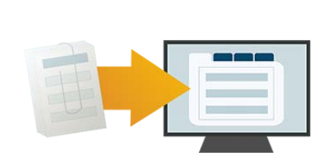
Grants.gov Workspace
Retire Legacy PDF Application Package
Legacy PDF Application Package will be phased out on December 31, 2017.
Applicants will no longer be able to download the older, single PDF application package of forms.
For any funding opportunities where applicants have downloaded the legacy PDF application package, they will be able to continue to submit that package until March 31, 2018.

Slide 3
Grants.gov Workspace
Retire Legacy PDF Application Package

Slide 4
Grants.gov Workspace
Workspace is a shared, online environment to collaboratively complete and submit grant applications.

Slide 5
Grants.gov Workspace
Benefits of Workspace
Multiple users can concurrently complete the application forms
Reuse/copy prior Workspace forms to prepopulate a new Workspace
Upfront validation allows applicants to correct application errors prior to submission thus drastically reducing the number of Grants.gov rejections
Complete an application form using our online webforms or downloading/uploading the PDF form; applicants can seamlessly switch between online and offline
Grantor changes to the Opportunity Package are immediately reflected in Workspace

Slide 6
Grants.gov Workspace
Workspace roles
E-Business Point of Contact (EBiz POC): Delegates Grants.gov roles and access
Authorized Organizational Representative (AOR) with MPIN: Submit any application on behalf of your Institute of Higher Education
Workspace Owner: Point person for proposal development.
Workspace Participant: All staff who complete or review any document or form that goes into the grant application.

Slide 7
Grants.gov Workspace
Workspace roles
UC San Diego users can register at the following link, and OCGA (Ross Dammann) will add the Manage Workspace access.
https://apply07.grants.gov/apply/OrcRegister

Slide 8
Grants.gov Workspace
Workspace process

Slide 9
Grants.gov Workspace
Workspace process

Slide 10
Grants.gov Workspace
Workspace process

Slide 11
Grants.gov Workspace

Slide 12
Grants.gov Workspace

Slide 13
Grants.gov Workspace

Slide 14
Grants.gov Workspace

Slide 15
Grants.gov Workspace

Slide 16
Grants.gov Workspace

Slide 17
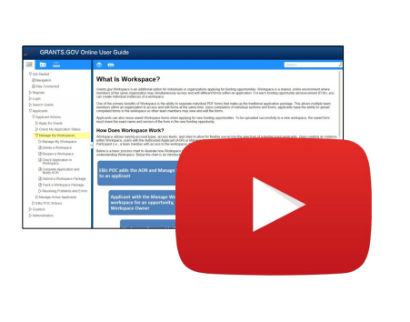
Grants.gov Workspace
Video: How to Create a Workspace
Video: How to Complete Forms in a Workspace

Slide 18
Grants.gov Workspace
Upcoming Workspace Enhancements
Allow Applicants to be added to a Workspace regardless of Organization affiliation
Forms-Level Access Control for applicants within Workspace
Workspace Progress Bar
Enhanced Workspace copy features
Include PDF attachments in Application Preview
One-Click Subscribe to Opportunity and Saved
More streamlined registration process

Slide 19
Grants.gov Workspace
Resources
Workspace overview: https://www.grants.gov/web/grants/applicants/workspace-overview.html
Grants.gov Community Blog article: “7 Tips for Transitioning Your Organization to Grants.gov Workspace” https://blog.grants.gov/2016/10/18/7-tips-for-transitioning-your-organization-to-workspace/
Grants.gov Workspace Roles and Access Levels – Training video: https://www.youtube.com/watch?v=4RnSfnZJB6w
Blog: “Defining Grants.gov Workspace Roles and Access Levels” https://blog.grants.gov/2017/03/13/defining-grants-gov-workspace-roles-and-access-levels/

Slide 20
Grants.gov Workspace
Questions?
Please feel free to contact me at jswarner@ucsd.edu or 858-534-6721.
OCGA Staff Assignment Tool:
http://blink.ucsd.edu/sponsor/ocga/staff-assignments.html

