Slide 1
Export Control Review for ORUBA
Garrett Eaton
UCSD Senior Export Analyst

Slide 2
Objectives
Gain a general awareness of export control regulations & how they impact UCSD research
Recognize red flags for export control risks in relation to international persons and shipping on campus

Slide 3
Government Concern Over Universities & Export Controls
Public cases of Export Violations involving Universities
Increased visits by federal agencies to Universities, FBI, BIS, ICE
Increased scrutiny
Economic espionage
May 20, 2016
April 30, 2018

Slide 4
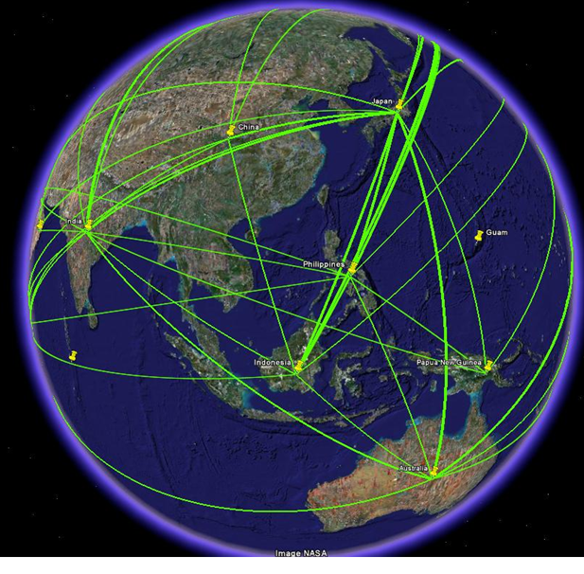
What is an Export?
Export means an actual shipment or transmission of items out of the United States. (EAR 734.2 (b))
Examples:
Physical shipment
Hand carry items or laptop overseas
Email
Posting or pulling from a FTP site
Accessing a server overseas
File Sharing with a foreign person or colleague overseas
Telephone or Fax
Visual inspection by a foreign person in the US or abroad of controlled technology

Slide 5
OFAC
Treasury
Sanctioned Countries
EAR
Commerce
Dual Use Items
ITAR
AFAEA
State
Military Items
DOE/ NRC
Nuclear Items
National Security
Foreign Policy
So… what ARE Export Controls?
Export Control Regulations

Slide 6
Spectrum of Research & Export Controls
Fundamental Research
Dual Use (EAR) Restricted Research
Military (ITAR) Restricted Research
Classified Restricted Research
Not Subject to Regs
Open Participation
US Citizens, Permanent Residents, Protected Persons Ok
Foreign Nat’l Licensing or Exception Required
US Citizens Only with Security Clearance

Slide 7
Fundamental Research Exclusion (FRE)
Covers: (1) information (not items); (2) resulting from “basic & applied research in science & engineering; (3) at an “accredited institution of higher education” (EAR); (4) “located in the United States” ; (5) that is “ordinarily published & shared broadly within the scientific community”
Notes:
The Fundamental Research Exclusion (FRE) exempts most on-campus university research from export control licensing requirements. It covers information (not items), resulting from basic and applied research in science & engineering, at an accredited institution of higher education, that is ordinarily published and shared broadly within the scientific community.

Slide 8
Limits of the FRE
Tangible exports of hardware, software, technology
Export controlled technology or technical data received from a sponsor or 3rd party
Export controlled activities – “defense services”
Fundamental Research does NOT cover --
Research involving creation or use of certain encryption source code
Sales and Service
Transactions involving sanctioned countries, individuals and entities and restricted end-uses must be reviewed independent of fundamental research, for licensing requirements.
Notes:
The FRE does not apply to tangible exports, export controlled technology or technical data received from a sponsor or 3rd party, export controlled services such as a defense service and research involving creation or use of certain encryption source code when the research involves nationals of Cuba, Iran, North Korea, Sudan and Syria including faculty, staff, student or visiting scholars.
Finally transactions involving sanctioned countries, individuals and entities and restricted end-uses such as chemical and biological weapon end-use, rocket or UAV end-use or nuclear end-use must be reviewed independent of fundamental research, for licensing requirements

Slide 9
WHO are we interacting with?

Slide 10
Restricted or Prohibited PARTY?
The US Government issues various lists of individuals & entities both in the U.S. & abroad that have committed export violations or other serious offenses.
Terms & conditions require no debarred, disqualified or ineligible persons
Part of funding awards, procurement & service agreements
Financial dealings or export transactions with Restricted or Prohibited parties is prohibited.
Terrorists
Weapons Proliferators
Export Violators
Drug Traffickers

Slide 11
How do you determine who is a Restricted Party?
Restricted Party Screening in the Visual Compliance Tool

Slide 12
Transactions That Need Screening
If you are conducting transactions with other persons, whether individuals or entities & whether in the U.S. or abroad, these restrictions apply to you. International transactions may include:
Collaborations – MTA’s, NDA’s, Licensing, Technology Transfer
Payments for goods or services (cash, check, wire transfer, or other means)
Contributions and donations of funds, materials or support
Export shipments either physical or electronic
Access to export restricted data or ITAR equipment
NDAs, Employees, students, visiting scholars in labs with access to restricted items, Sales & Service
All the parties to a transaction
Notes:
How many use a software tool for screening?

Slide 13
Restricted Entities University Examples -not comprehensive
BEIJING UNIVERSITY OF AERONAUTICS AND ASTRONAUTICS (BUAA) AKA BEIHANG UNIVERSITY- China
NORTHWEST POLYTECHNICAL UNIVERSITY-Xian, China
SICHUAN UNIVERSITY- Chengdu, China
UNIVERSITY OF ELECTRONIC SCIENCE AND TECHNOLOGY OF CHINA - Chengdu, China
National University of Defense Technology- China
MALEK ASHTAR UNIVERSITY OF TECHNOLOGY- Tehran, Iran
BAQIYATTALLAH UNIVERSITY OF MEDICAL SCIENCES – Tehran, Iran
IMAM HOSSEIN UNIVERSITY- Tehran, Iran
BEN GURION UNIVERSITY (BGU)- Israel

Slide 14
What is a Deemed Export (EAR)?
Any release of technology or source code subject to the export regulations to a foreign national. Such release is deemed to be an export to the home country or countries of the foreign national.

Slide 15
What is a Foreign Person?
Foreign Person
Any person not granted political asylum
Foreign Entity
Any partnership or group not incorporated or organized to do business in the U.S.
Any U.S. Person employed or representing a foreign entity
Any foreign government
Any person not a U.S. citizen or legal permanent resident (green card holder)

Slide 16
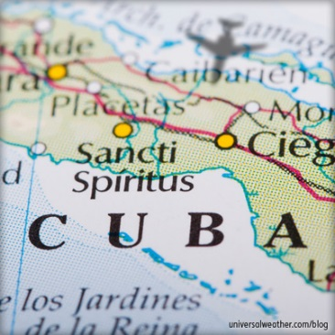
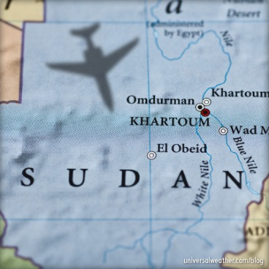
Sanctioned Countries
OFAC Comprehensive Sanctions for imports, exports, financial transactions and services for
Cuba, Iran, North Korea, Syria & Sudan
Contact ECO for transactions with any of these countries
Other countries with non-comprehensive sanctions include: the Crimea region of Ukraine, Belarus, the Balkans, Central African Republic, Cote d’Ivoire, Iraq, Lebanon, Libya, Somalia, South Sudan, Venezuela, Yemen, Zimbabwe and the former Liberian Regime of Charles Taylor.
This list is not exhaustive

Slide 17
I-129 Export Certification
Requires UCSD to indicate to the federal government whether an export license is required for that individual’s work at UCSD.
This UCSD form was updated to include Export Control as the contact office for reviews
Access to export restricted technology may require export licenses:
access to info under a NDA
Access to ITAR equipment or technology
Participation in Service Agreements or other work not covered by the fundamental research exclusion

Slide 18
Licensing Timeframes, Plan Ahead
Accommodate export licensing into your research timetable (6 weeks to 3 months for Gov’t approval)
BEFORE any controlled item/technology can be exported abroad or with a foreign national (even if in your own lab)
BEFORE the transfer of information required to develop research proposals
BEFORE undertaking the international collaboration or activity

Slide 19
Physical Shipments & Hand Carries
Any physical shipment or hand carry outside the US is considered an “export”
Shipments performed for a UCSD business/research purpose must be reviewed by the Export Control Office for license determinations prior to shipping
Even temporary exports, such as UCSD-owned equipment taken abroad for research and returning to the US, are subject to EC regulations
Laptops containing technical data or proprietary information could trigger licensing requirements
Encrypted hard drives may prove problematic at customs
Export Control Office can provide hand carry travel letters on request

Slide 20
Classification: What am I shipping?
Export Control Classification Number (ECCN)
Commerce / EAR Controlled items (e.g. 6A001, 8C001)
EAR99 – Not specifically listed on the CCL, but still subject to Export Controls
ITAR Classification
USML list – Roman numeral categories (e.g. XII, XX, etc.)
HS-Harmonized System Tariff code
Internationally standardized system of names and numbers for classifying traded products
Schedule B (U.S. Exports)
Improper classification can lead to fines

Slide 21
Documentation - Invoice
Commercial or Pro Forma Invoice with an itemized list of the goods you’re shipping (part of the Invoice), including the following for each item:
detailed, identifying DESCRIPTION (serial numbers, model numbers, manufacturer, etc.). No Jargon or Shorthand.
VALUE – purchase price, for custom-made items include cost of materials and labor
WEIGHT
Country of Origin (COO) – Country of Manufacture
Export Control Classification Number (ECCN)
Commodity Classification - Schedule B or Harmonized Tariff Code (HS/HTS code)
INCOTERMS

Slide 22
Requesting Export Control Classification
The best place to get Export Classification is the Manufacturer
Email or call the OEM or vendor and request “Export Classification”
Having Export Classification documented in writing is preferred
Classification will either be the
ITAR Category ( a roman numeral, ex. XII) or
Export Control Classification Number (ECCN, e.g. 6A002)
If shipping, also request the HS Code, also called the HTS code, Harmonized Tariff code or Schedule B number
Include this information on the invoice and forward a copy to the Export Control Office – export@ucsd.edu
NOTE: Any ITAR items will likely require an export license for use in international waters or for shipment to other countries or for use by foreign persons

Slide 23
Export Licensed Items
When shipping or hand carrying items under an export license:
Coordinate with the Export Control Office
For ITAR licenses, US customs may be required to sign off on the license in and out of the US
AES is required regardless of value – the Export Control Office will file this

Slide 24
Red Flags
Does the Research or Activity involve:
DoD or Military contractor Funding (Navy, DARPA, Northrup Grumman, etc.)
Military, Space, Encryption, Nuclear technology
A foreign entity?
Collaboration with a foreign military or space agency?
A restricted party?
Shipping/ transferring items to a foreign country?
Collaborating with foreign colleagues in foreign countries?
Working with a country subject to US sanctions?
Cuba, Iran, North Korea, Syria and Sudan

Slide 25
Costs of Export Violations
Price of non-compliance can result in negative publicity, put your funding at risk, result in penalties & fines –
$250,000 to $1,000,000
Criminal offenses can result in imprisonment
Imprisonment for persons that export goods with knowledge of or reason to believe that a violation will occur
Puts federal funding at risk – for UCSD & the PI
Denial of export privileges, can destroy int’l activities
& collaborations
Placement on the denied parties list
Negative publicity

Slide 26
Videos
Topics:
University Research: 6 minutes, 45 seconds
Traveling abroad: 4 minutes, 28 seconds
ITAR: 7 minutes, 40 seconds
Biological Agents: 5 minutes, 4 seconds
OFAC: 3 minutes, 52 seconds
Who should watch them?
Students, post-docs, researchers
Staff – use as part of new hire training or watch when you have a question
Faculty
TO COMPLY WITH EXPORT CONTROLS
http://blink.ucsd.edu/sponsor/exportcontrol/training.html

Slide 27
Export Control Office
Brittany Whiting, Export Control Officer
Garrett Eaton, Senior Export Analyst
Ryan Jordan, Export Analyst
(858) 246-3300
export.ucsd.edu
export@ucsd.edu

